Slide 1

SENTINEL AI
One app to prevent, predict & resolve cyber threats

Slide 2


TEAM DETAILS
Team Leader: Sai Shruthi V - CSE 2nd year
Innovation Squad:
Sadhana V
Vishwapriya M
TEAM NAME : “ENCRYPTED ELITE”
KCG COLLEGE OF TECHNOLOGY

Slide 3
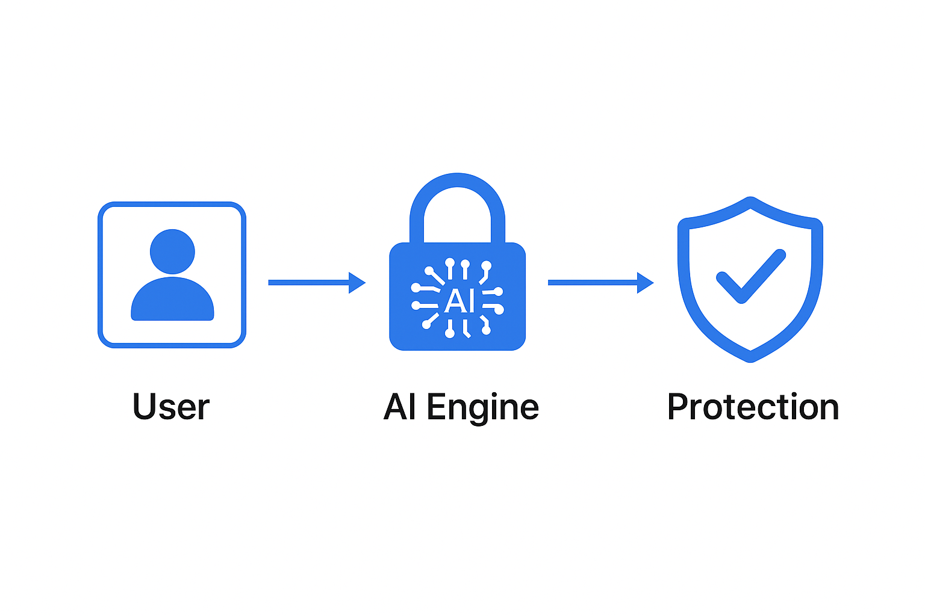
Problem Statement
Cyber-attacks increasing every year (phishing, ransomware, identity theft).
Users lack awareness & proper tools → personal & financial losses.
Current solutions = multiple apps, complex setup, high cost.
Need: Single , Smart platform to safeguard data & privacy.

Slide 4
Solution
All-in-one AI-powered security app that monitors, predicts, and automatically resolves cyber threats.
Features
Threat detection in
Real time
Secure password vault&
2FA manager
Phishing/ Malware blocking
Data leak alerts &
Auto patching

Slide 5
Methodology
AI/ML Models-> anomaly detection & behaviour analysis
Continuous learning from threat database
Auto Remediation workflows
Data collection from user inputs
AI-based threat analysis
Risk classification
Alert and resolution mechanism

Slide 6
Flowchart
User Interaction
Data Collection& Analysis
Threat Prediction & Detection
Automated Response
Continuous Learning
Protection &
Reporting

Slide 7


Technology Stack
Backend: Python, Tensorflow , Scikit- learn (ML)
Frontend: Flutter (cross- platform mobile)
Security Tools: AI/ML Models for threat detection (NLP, anomaly detection), antivirus APIs
Reason: Robust ML ecosystems + Flutter gives single code base for Android/iOS.

Slide 8
Target Industry & Feasibility
Target Users:
Individuals( students, professionals)
Small business & Startups
Feasibility:
Light weight app with minimal resource
Subscription model for premium support
Value add: 24×7 smart protection without expertise

Slide 9
Unique Selling Preposition (USP)
Aspect | Existing Solutions | Our AI Cybersecurity App
Coverage | Separate tools for antivirus, password manager, VPN, breach alerts | All-in-one platform handling every major security need
Ease of Use | Multiple installations & subscriptions | One installation, simple dashboard
Intelligence | Mostly signature-based detection | AI/ML for real-time prediction & learning
Updates | Manual or periodic updates | Continuous self-learning & auto-updates
Cost | Pay for several products | Single subscription, more affordable
User Type | Requires some technical skill | Beginner-friendly; guides users automatically
All-in-one cyber security solution
AI-based prediction and auto-response
Easy to use for non-technical users
Cost-effective compared to multiple apps

Slide 10

Impact & Benefit
Reduces cyber fraud and identity thief
Improves cyber awareness
Saves time and money
Enhances digital safety for userst

Slide 11
Research & References
OSWAP &NIST Cybersecurity guidelines
IBM Security Reports (2023-2024)
“AI for Cyber Security” – IEEE papers
cybersecurityventures.com

